Slide 1
Przyszłość transplantologii
Seminarium IV rok kierunek lekarski
Klinika Transplantologii i Chirurgii Ogólnej
Prof. dr hab. Zbigniew Włodarczyk
Dr n. med. Marek Masztalerz
dr n. med. Aleksandra Woderska
Lek. med. Emilia Wojtal

Slide 2
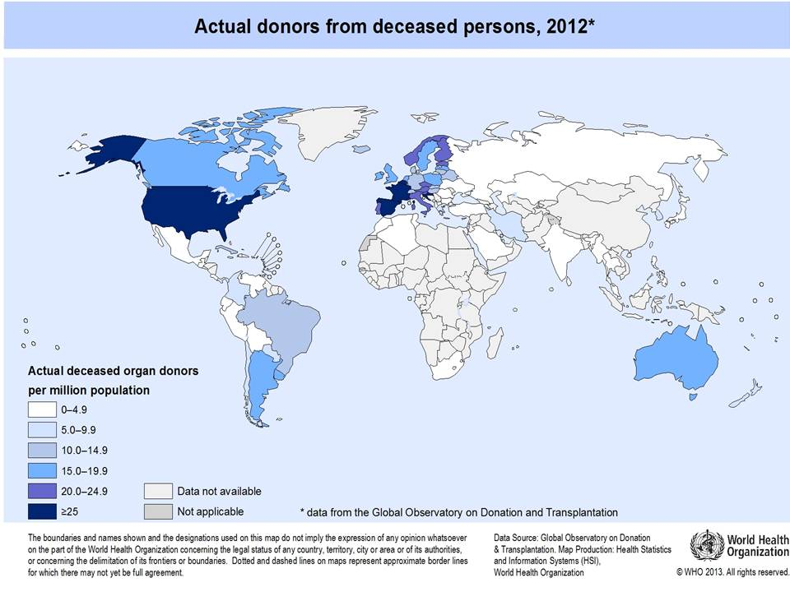
2

Slide 3
LIMITATIONS ON THE POSSIBILITY OF TAKING ORGANS FROM HUMANS
Od zmarłych:
From cadaveric donors:
*reduced number of injuries
*reduced mortality after injuries
*more effective treatment of CNS bleeding
*revitalization of brain structures ???
From the living:
*aging population
*ethical constraints

Slide 4
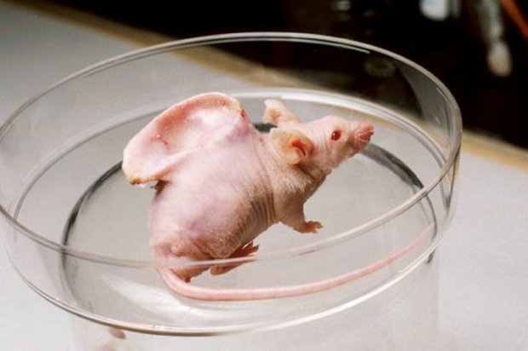
ORGAN CULTURE
https://wyborcza.pl/magazyn/7,124059,16110682,dziecko-uszyte-na-miare.html

Slide 5
https://www.ondacero.es/noticias/ciencia-tecnologia/cientificos-espanoles-cultivan-embriones-quimera-monos-celulas-humanas_2021041560788b3b8beb390001502941.html

Slide 6
https://slideplayer.pl/slide/88969/

Slide 7
https://slideplayer.pl/slide/88969/

Slide 8
https://slideplayer.pl/slide/88969/

Slide 9
https://slideplayer.pl/slide/88969/

Slide 10
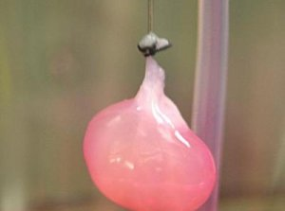
April 14, 2013, Massachusetts General Hospital
„Bioengineered rat kidneys successfully produced urine both in a laboratory apparatus and after being transplanted into living animals. The research team built functional replacement kidneys on the structure of donor organs from which living cells had been stripped, an approach previously used to create bioartificial hearts, lungs and livers”
10
https://kopalniawiedzy.pl/szukaj

Slide 11
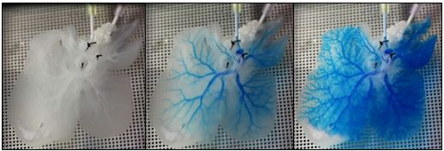
https://mirm-pitt.net/engineering-a-functional-whole-organ-for-transplantation/

Slide 12
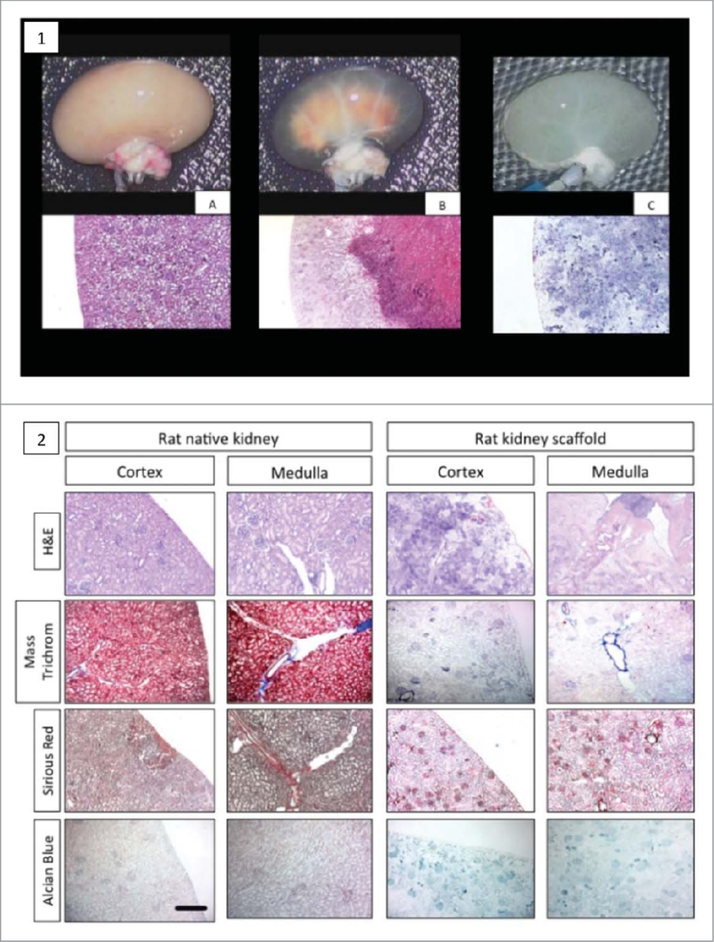
https://www.researchgate.net/figure/Decellularization-process-and-extracellular-matrix-analysis-of-rat-native-kidney-compared_fig1_280116830

Slide 13
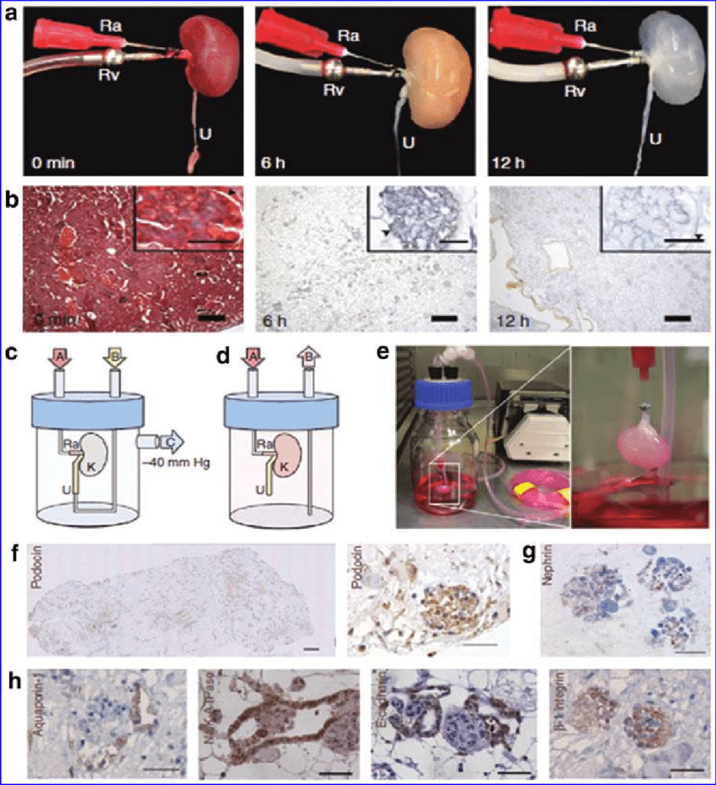
https://www.researchgate.net/figure/Decellularization-process-and-extracellular-matrix-analysis-of-rat-native-kidney-compared_fig1_280116830

Slide 14
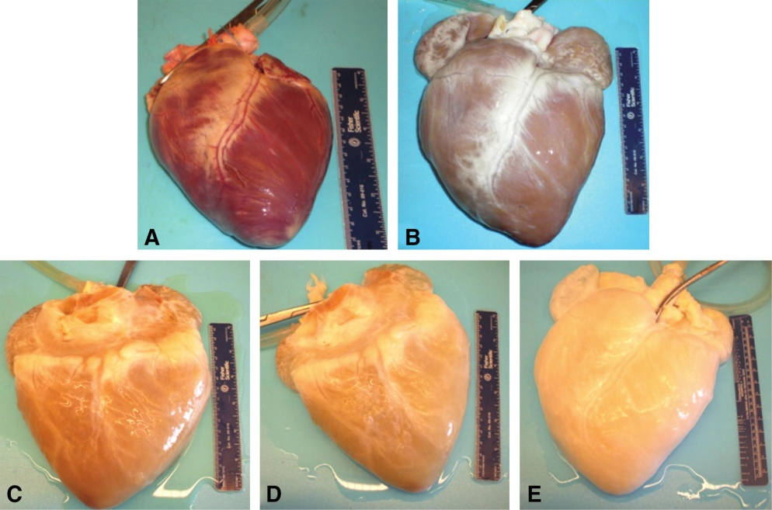
https://www.researchgate.net/figure/Decellularization-process-and-extracellular-matrix-analysis-of-rat-native-kidney-compared_fig1_280116830

Slide 15
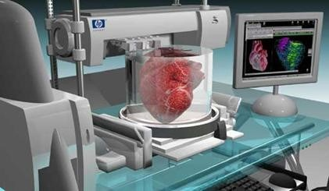
3D PRINTING

Slide 16
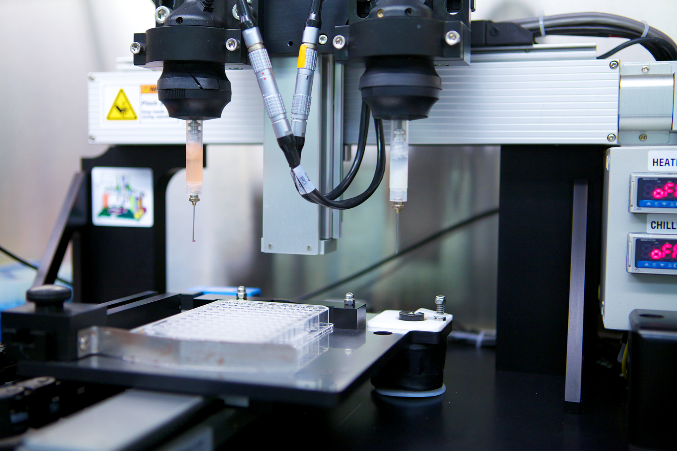
https://commons.wikimedia.org/wiki/File:Heart_printing.png

Slide 17
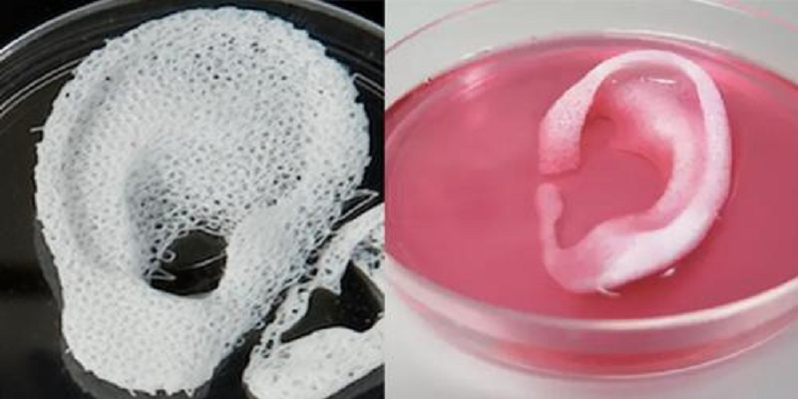
https://www.thetimes.com/article/3d-printed-organs-to-solve-donor-shortages-v859730d3

Slide 18
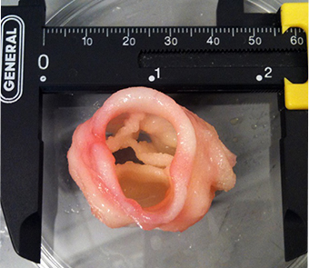

Slide 19
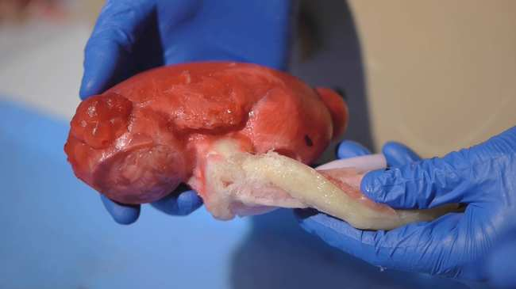
https://www.urmc.rochester.edu/news/story/creating-the-model-human-to-practice-surgery

Slide 20
ARTIFICIAL ORGANS
advantages:
no immunological barrier
full sterility
immediate access ("off the shelf")
disadvantages:
Cost
power supply

Slide 21
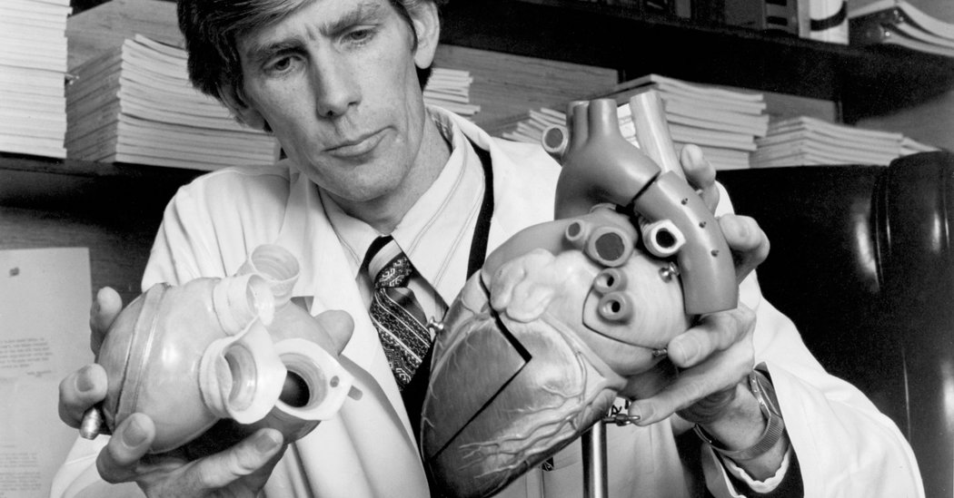
An Illustrated History of Transplantation, Sandoz 1999

Slide 22
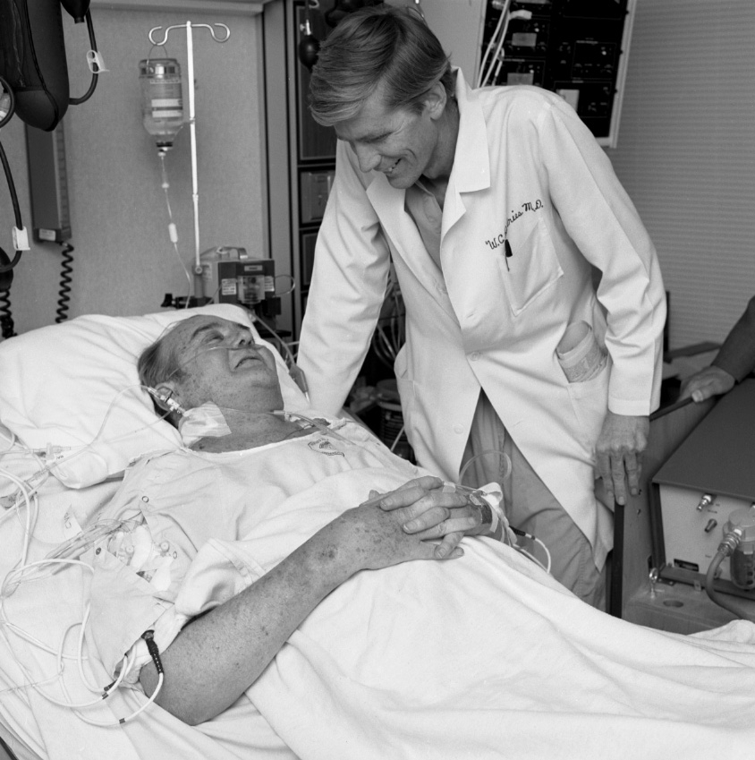
An Illustrated History of Transplantation, Sandoz 1999

Slide 23
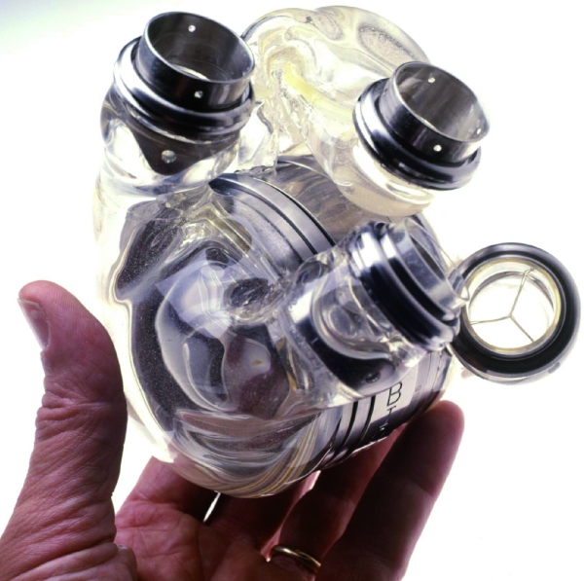
An Illustrated History of Transplantation, Sandoz 1999

Slide 24
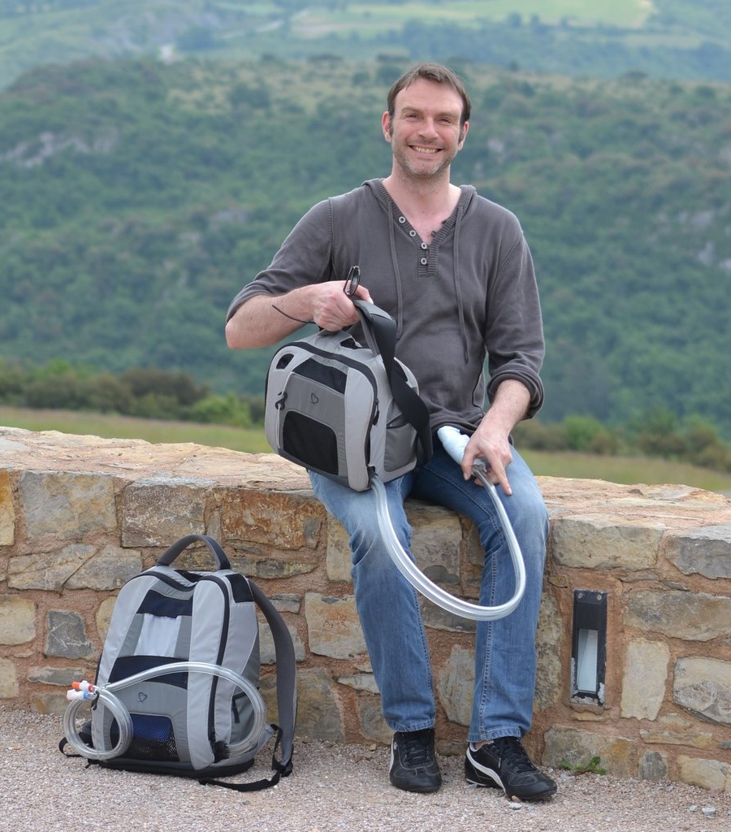

Slide 25
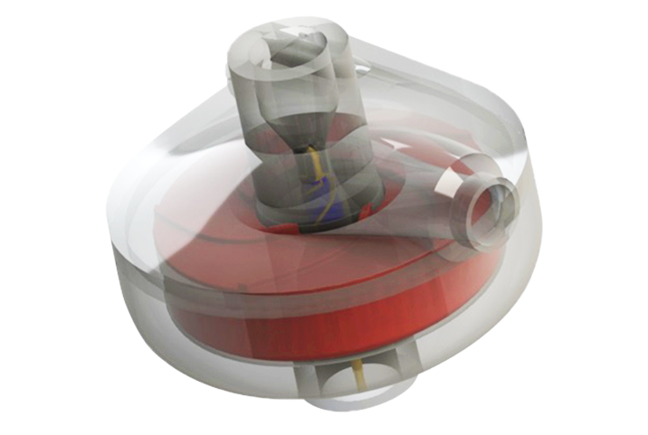
An Illustrated History of Transplantation, Sandoz 1999

Slide 26
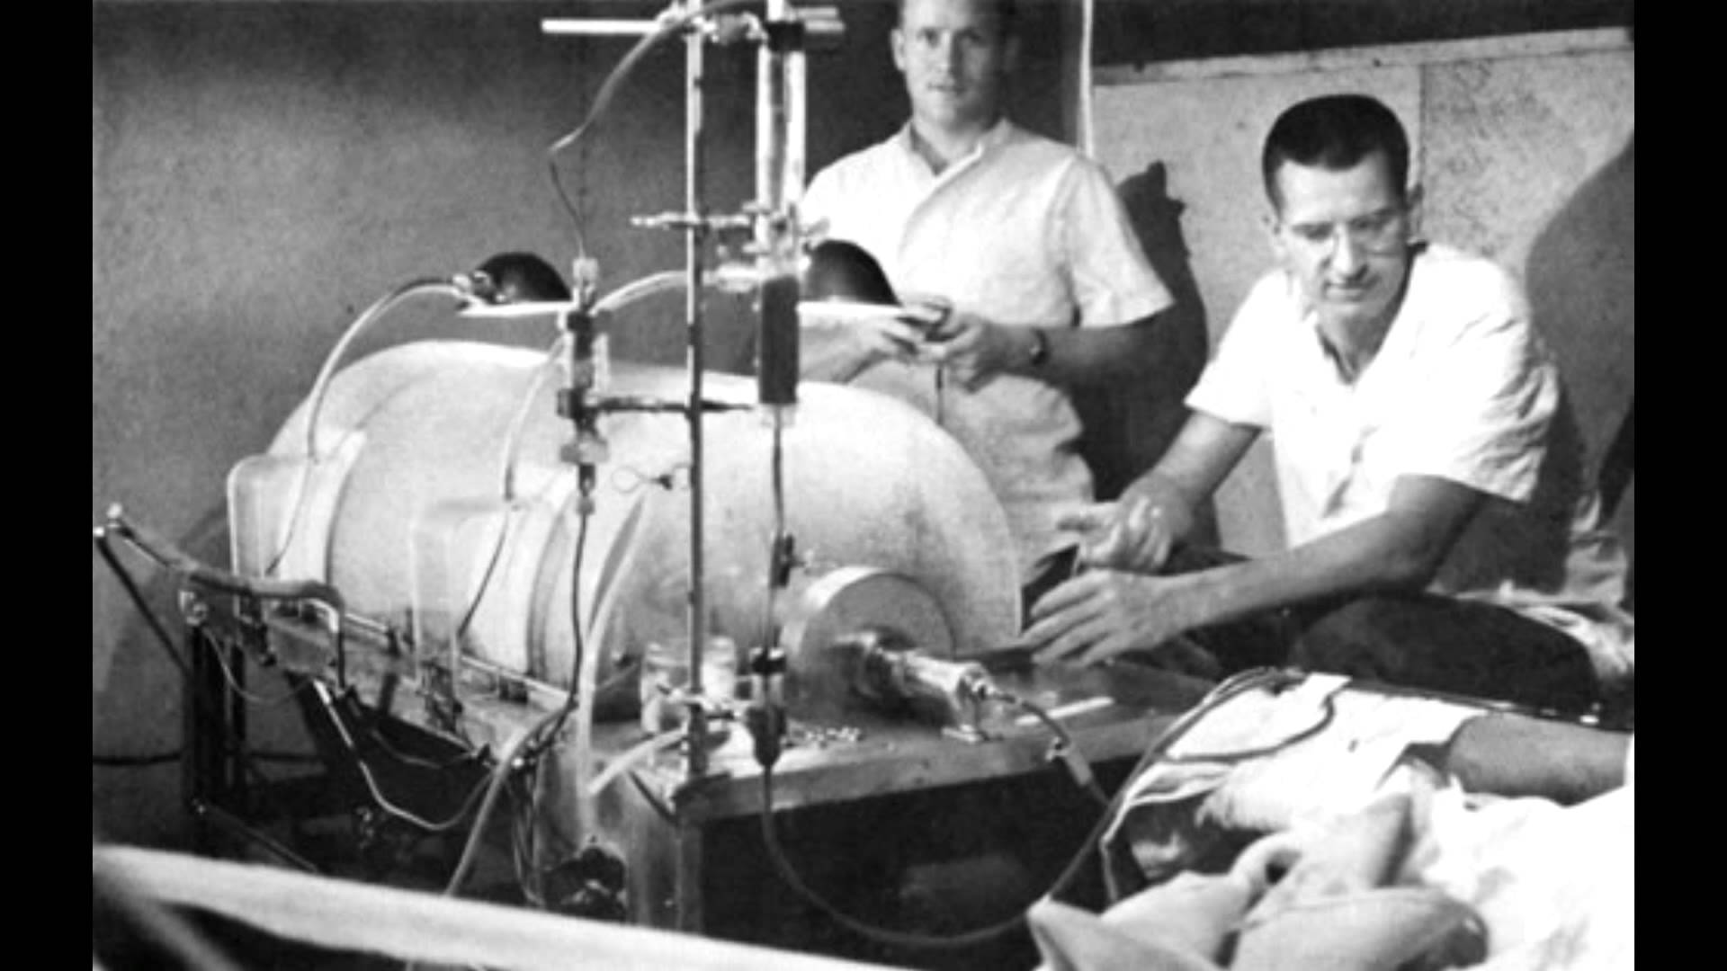

Slide 27
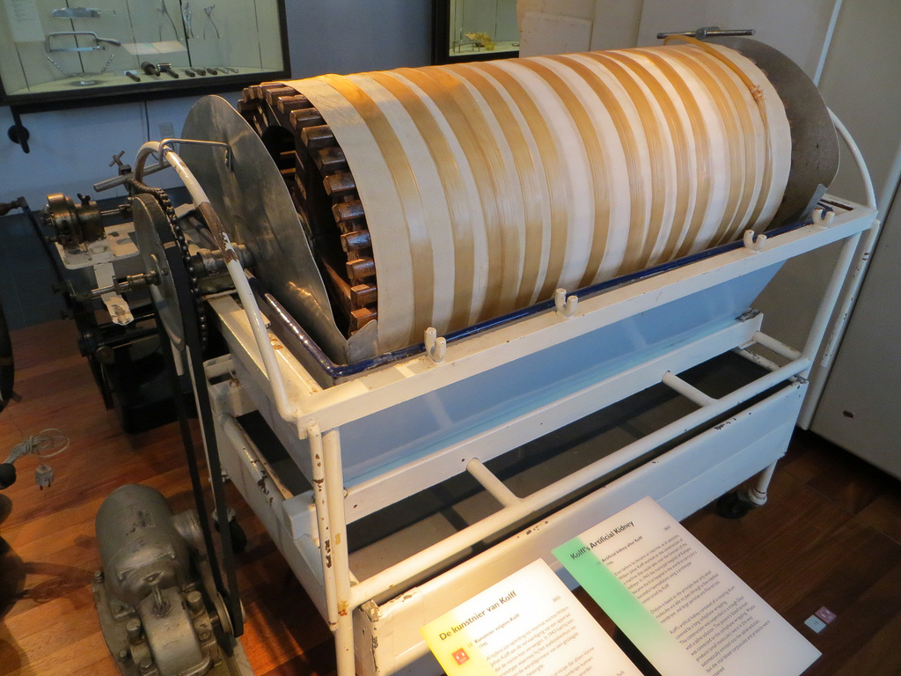
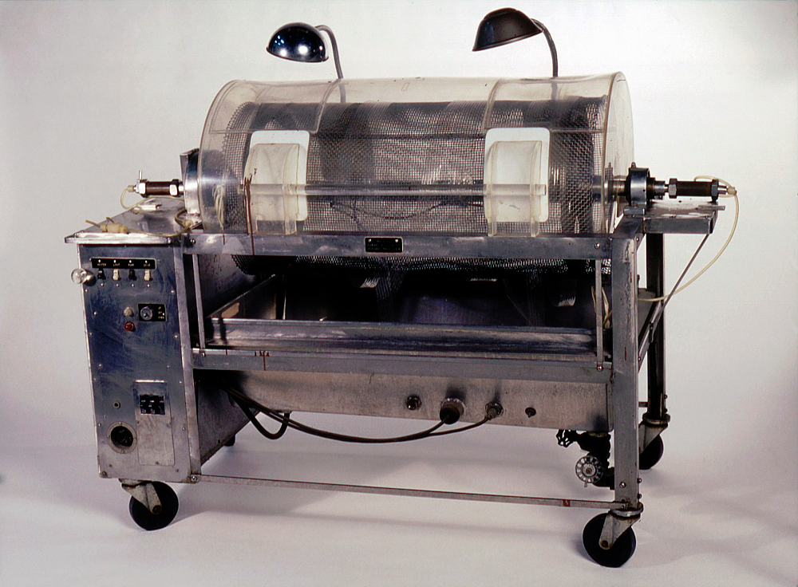
An Illustrated History of Transplantation, Sandoz 1999

Slide 28
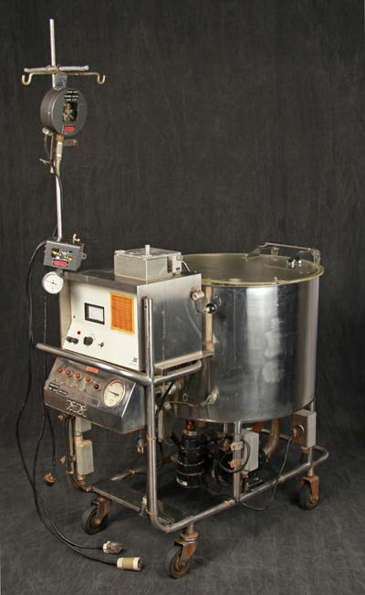
https://artsci.case.edu/dittrick/online-exhibits/explore-the-artifacts/artificial-kidney-1963/

Slide 29
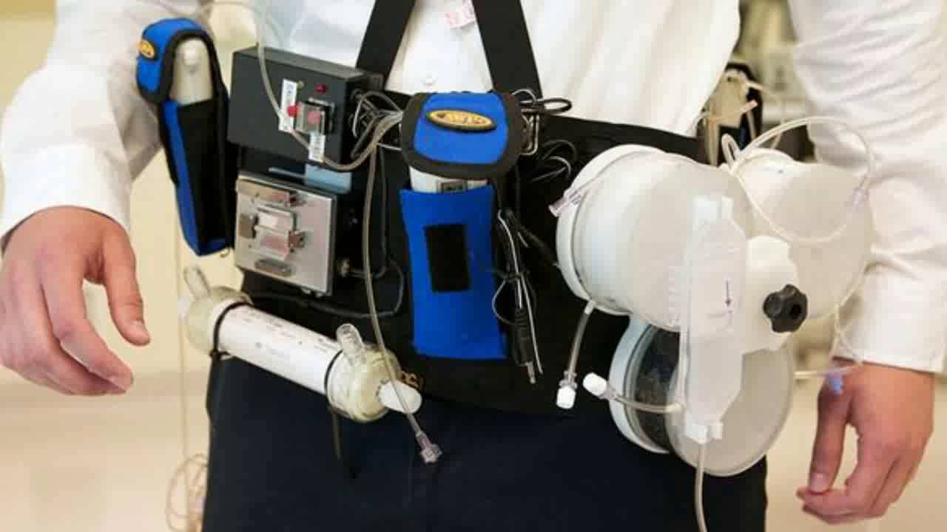
https://mlodytechnik.pl/technika/28782-technologie-medyczne-przyszlosci

Slide 30
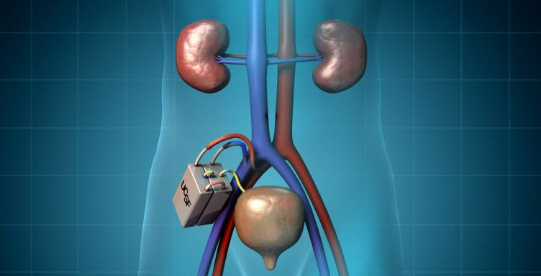
https://uomus.edu.iq/En/EnNewCol.aspx?depid=13&newid=15023

Slide 31
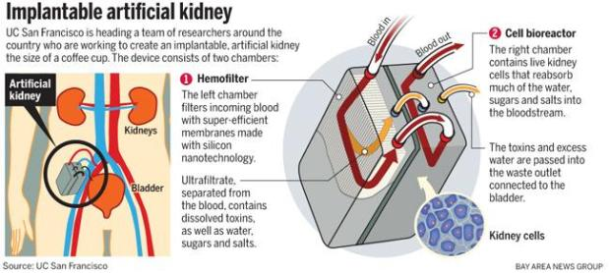

Slide 32
XENOTRANSPLANTATIONS
Expected problems:
immunological barrier
dangers of genetic humanization of animals
genomic viruses
differences in secretory function
differences in growth rate
organizational protests
ethical problems

Slide 33
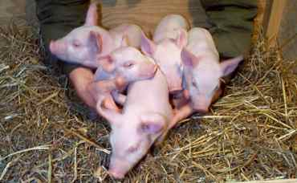
SOURCES OF XENOTRANSPLANTS
Close species (concordant)
great apes
monkeys
Distant species (discordant)
pigs
https://cursinhopreenem.com.br/biologia/os-mamiferos/

Slide 34
Zoonotic infections – interspecies passage
Primate and Porcine Endogenous retroviruses (PRERV and PERV)
Tightly integrated into the animal genome
High localization variability
Can infect humans
Detection may be impossible
In the case of integration into the genome of a reproductive cell - inherited
160 xenotransplant recipients: PERV detected in 30 recipients!!!!

Slide 35
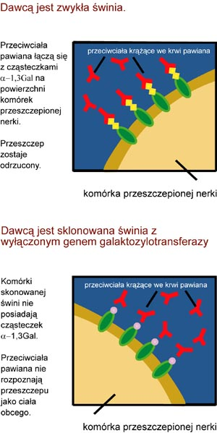
Xenotransplantation immunology- "discordant" species
Gal-α-1,3-Gal Epitope
Preformed Antibodies
Hyperacute Rejection
Acute Rejection
Chronic Rejection

Slide 36
Xenotransplantation immunology – what's next?
RECIPIENT MODIFICATION
DONOR MODIFICATION
Miniature transgenic pigs
lack of Gal-α-1,3-Gal epitope
membrane factor protein – reduced complement activation
Antibody Removal
Complement Inhibition
Immunosuppression

Slide 37
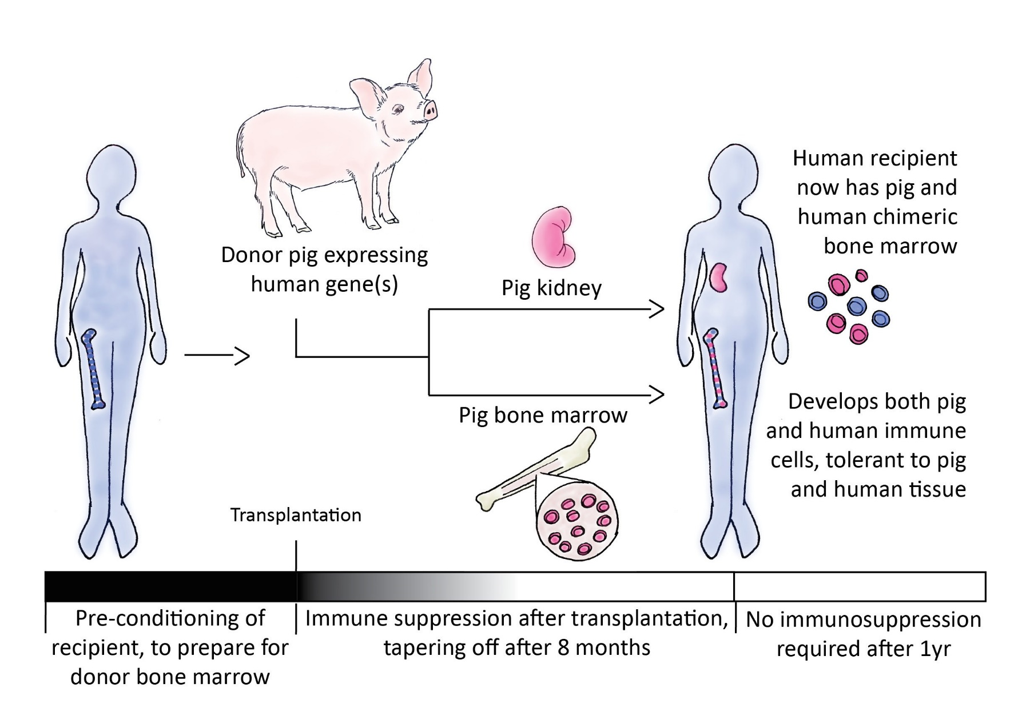
https://blogs.ubc.ca/xenotransplantationandethics/biotechnology/

Slide 38
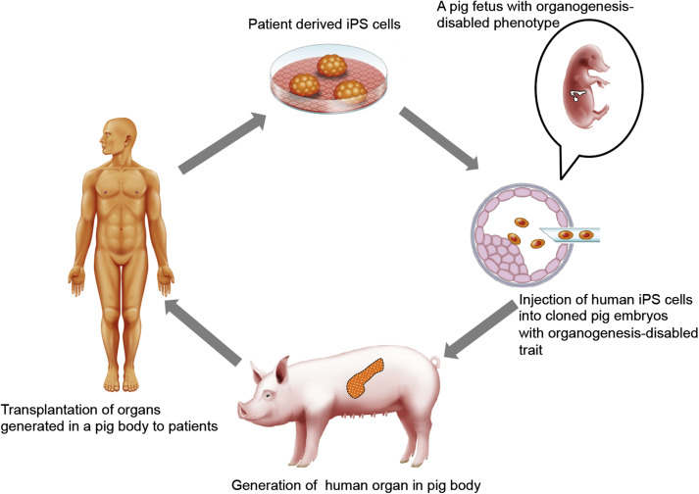

Slide 39
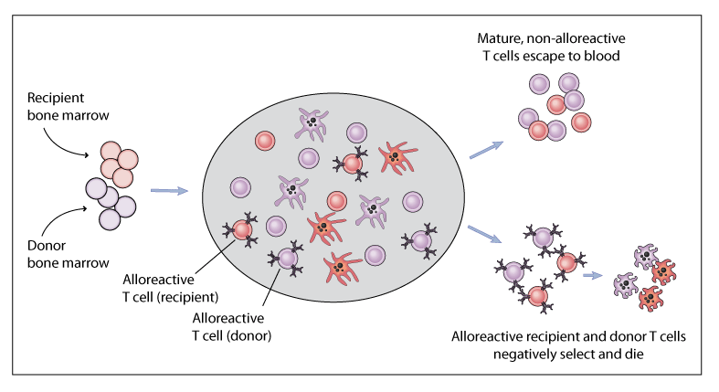
https://www.immunetolerance.org/news/2009/02/first-subject-transplanted-expanded-study-mixed-chimerism-kidney-transplantation

Slide 40
THANK YOU FOR YOUR ATTENTION

